Slide 1
Creating Safe Shelter for Native Women and Children
Germaine Omish-Lucero, Special Projects Director
Alliance of Tribal Coalitions to End Violence
| This project is supported by Grant No. 2017-TA-AX-K073, awarded by the Office on Violence Against Women, U.S. Department of Justice. The opinions, findings, conclusions, and recommendations expressed in this document are those of the author and do not necessarily reflect the view of the U.S. Department of Justice, Office on Violence Against Women. |

Slide 2
Strengthening Tribal response to end violence against native women
Here are some friendly housekeeping reminders:
Your control panel will appear on your user screen
All attendees will be muted during this presentation
Once you call into the meeting call line, enter your pin#
Use the questions box on your panel to submit questions and responses
During the discussion portion, please ‘raise’ your hand by clicking the hand icon to signal to be unmuted
To minimize the control panel, use the orange arrow at the top left panel

Slide 3
Who are Training and Technical Assistance Providers?
www.law.und.edu/npilc/TJI
www.AKNWRC.org
www.Home.TLPI.org
www.TribalResponse.org
www.ATCEV.org

Slide 4
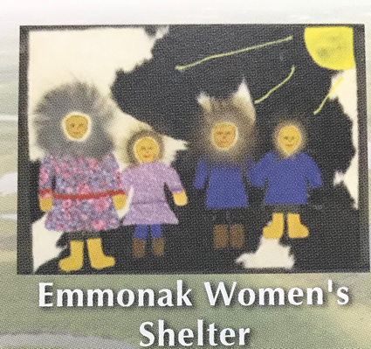
And Direct Service Providers:
www.EmmonakShelter.org
www.sno-nsn.gov/services/dv
www.OKNAAV.org

Slide 5
What is the Initiative About?
The Strengthening Tribal Response to Violence Against Native Women Initiative
Provides training, technical assistance and resources to tribal government or tribal community not currently receiving Office on Violence Against Women (OVW) grant funding to enhance victim safety and more effectively address offender accountability.
www.TribalResponse.org

Slide 6
www.TribalResponse.org
Features of the website include:
Critical resources and tips for strengthening responses that prioritize victim safety & offender accountability
Resources for tribal protection orders
Critical resources for victim safety planning
Resources to design and implement community education and awareness
Information on community and systems-based victim advocacy
Resources to increase tribal capacity to develop and sustain shelter and safe housing

Slide 7
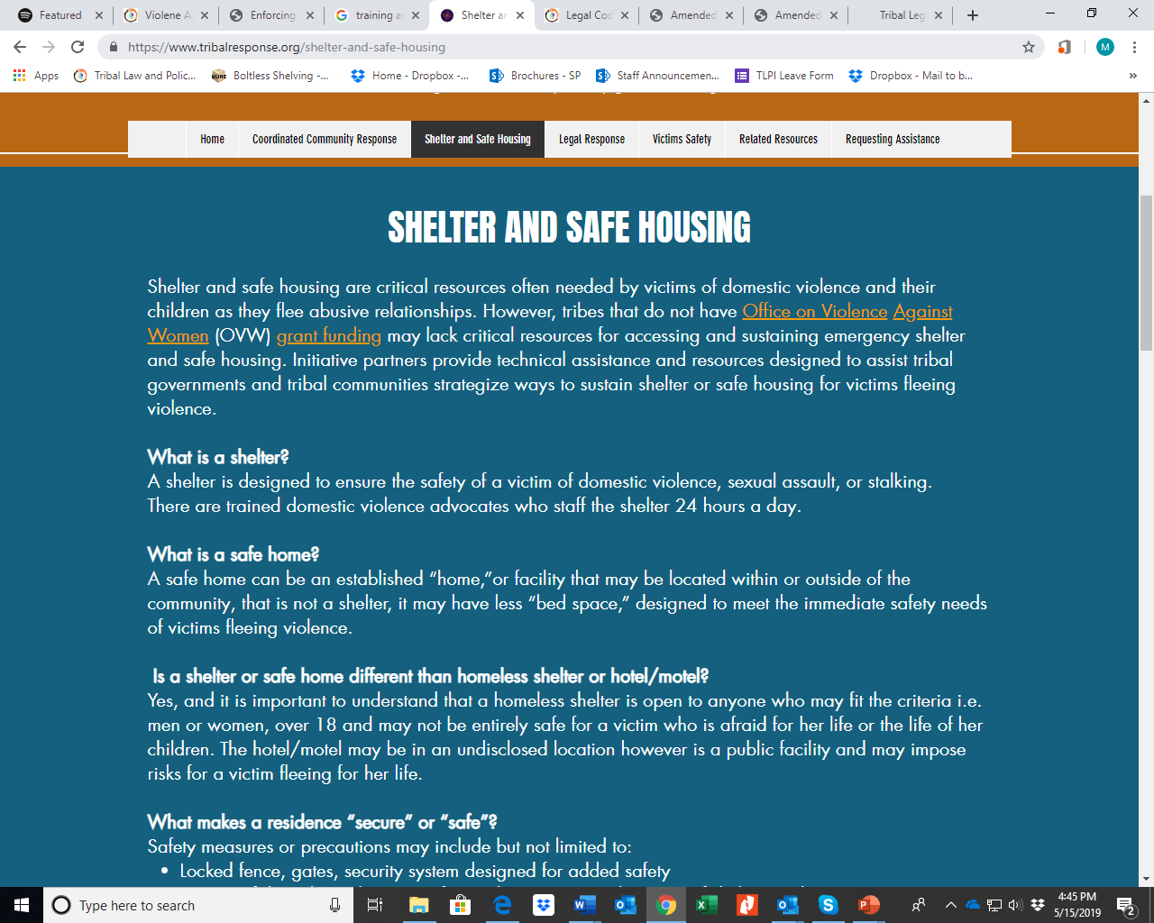

Slide 8
General Shelter Information

Slide 9
Difficulties for victims going to shelter
There are many reasons why it’s difficult for victims of domestic violence to enter a shelter for safety. Shelters or safe homes are difficult for many victims to enter, but are even more so for Native victims.
Finding Shelter:
No beds available
Long intake process
Required classes
Lack of traditional/culturally appropriate services
Restrictions:
Lock down
Cannot work
No boys 13 years or older
No substance abuse issues

Slide 10
“Our community lacks resources for accessing and sustaining shelter or safe housing for victims fleeing violence, can you help us address this issue?”
Shelter and Safe Housing

Slide 11
Shelter goals to consider
Purpose of Shelter for _____Tribe
Mission or Philosophy? How does this fit with generally how the development of this shelter fits with the tribe’s belief about sacredness of women and importance of exercising tribal sovereignty to protect women and children
Potential Services Provided within the Shelter and how they reflect tribal traditions of taking care of one another, feeding one another, helping one another with the children, etc.
What types of forms may be needed such as Contact Sheet, Release of information, Victim Rights, Resources and a Resident handbook aka “A Guide to Harmony.”

Slide 12
Shelter Policy for Staff & Residents
Every shelter is unique and therefore, the policies established for each shelter will vary. There will be some basic policies that are across the board but beyond this, every shelter should develop policies that will reflect the type of shelter they are providing, such as emergency, long-term, or transitional housing.

Slide 13
Consideration for your shelter
Consider the location of your shelter, is it on the reservation or off?
If your shelter is on the reservation, tribal codes may be in place that the shelter will have to follow.
If the shelter is off the reservation, make sure that you are aware and have incorporated any city, county, and/or state codes into your shelter policies.

Slide 14
Items to consider for your facility
Action Plan
Schedule of Hours
Expected Behavior (for staff and for residents)
Residents Belongings
Keeping Clean
Confidentiality (for staff and for residents)
Mail
In Case of Emergency
Tribal Cultural practices
Violations of Code of Conduct (for staff and for residents) (ex. Weapons, drugs, alcohol use, cannabis)
Suspension- Appeal Procedure (for staff and for residents) (ex. Weapons, drugs, alcohol use, cannabis)
List of Misconduct Consequences
Smoking Policy
Laundry Schedule
Meal Schedule
Visiting Hours
Dress Code
Notes:
The Open Door Shelter
Where Hope Begins
Resident Handbook
http://www.opendoorshelter.org/wp-content/uploads/NORW_ResidentHandbook.pdf
Back in the day, Cangleska had some really cool materials on shelters. Like their resident guidebook was called something like “A Guide to Harmony: For Women and Children in Shelter” or something like that. I like that it didn’t sound so punitive but that the rules existed for a reason and it’s important to communicate why particular rules are in place otherwise it may feel punitive or about power and control much like that that the batterer imposed.
They had 4 basic rules
No physical discipline or corporal punishment of children or called names, because children are sacred. They also provide a handout on alternative ways to discipline children.
No alcohol or drugs or drinking or drug use in the shelter
No weapons in the shelter
Take responsibility for self, cleaning up after yourself etc.
The rest was shelter expectations and services provided in the shelter, importance of confidentiality, cultural and spiritual activities available, when advocates are available and services they provide, play areas, communal areas and taking responsibility in those areas, phones, visitors (most shelters have a no visitor policy due to confidentiality concerns), coming and going out of shelter, children, sleeping space and there could be changes due to the need to accommodate others in need of space, house meetings and communal living, laundry, grievance procedures, checking out

Slide 15
Resident establishment
Phase I: New Resident Orientation
Examples of, but not limited to:
Meeting with your advocate to go over shelter Code of Conduct
transitional plan
length of stay
services and evaluation
establish your goals and objectives
Chores
Job opportunities as you complete phases
Attend in-house groups/meetings/services
Phase II: Established Resident
Examples of, but not limited to:
going out into community to complete goals and objectives.
Such as looking for/going to work, school
Getting needed documents such as driver license, birth certificates, Social Security Cards, etc.
Setting up services such as TANF, WIC, Counseling
Phase III: Established Resident cont.
At this phase, resident should have:
A job, or some vocational, educational, support services treatment program
The Open Door Shelter
Where Hope Begins
Resident Handbook
http://www.opendoorshelter.org/wp-content/uploads/NORW_ResidentHandbook.pdf
Notes:
The Open Door Shelter
Where Hope Begins
Resident Handbook
http://www.opendoorshelter.org/wp-content/uploads/NORW_ResidentHandbook.pdf
Good to say, shelter staff available to help you with such things as goal setting, acquiring personal belongings, career planning, self care opportunities, etc.

Slide 16
General Recommendations Regarding Shelter Policies
Rules/Policies/Guidelines should positively reflect your agency's mission and values.
All the written material a program gives clients, including rules/guidelines/program policies should be friendly and invite cooperation, collaboration and mutual accountability in their tone and wording.
Excerpt from:
Model Rights and Responsibilities final for Shelters
Washington State Coalition Against Domestic Violence
Notes:
Excerpt from:
Model Rights and Responsibilities final for Shelters
Washington State Coalition Against Domestic Violence

Slide 17
Rules/guidelines/program policies should make a clear distinction between behaviors that facilitate communal living and behaviors that threaten a resident’s ability to stay at the shelter.
Whether or not someone cleans the kitchen on time is not a threat to safety or harmonious communal living on the same level as whether or not they bring a gun into the building.
Best practices separate out information and expectations about communal living (detailed info about cleaning, diaper disposal, chores, bathroom use, etc.) from the sorts of things that threaten safety (guns, drugs, threats of violence, alcohol, etc.).
When a client first arrives, it is not necessary to go into great detail how people get kicked out of the program; this can be alienating and feel threatening.
Excerpt from:
Model Rights and Responsibilities final for Shelters
Washington State Coalition Against Domestic Violence
Notes:
Excerpt from:
Model Rights and Responsibilities final for Shelters
Washington State Coalition Against Domestic Violence

Slide 18
Generally, we should strive to focus on advocacy vs. rule enforcement
If advocates are spending the bulk of their time on rule enforcement, precious resources are being misused.
An emphasis on rule enforcement over advocacy undermines trusting relationships between residents and staff, and can result in low staff morale as well.
It can help to keep in mind that when a client breaks a rule, it is a great opportunity to find out what their real needs are.
Unless the rule violation created a clear danger to others in the shelter and it is simply untenable to have the resident stay, a good advocate will work to find out what the issues are behind the rule problem.
Excerpt from:
Model Rights and Responsibilities final for Shelters
Washington State Coalition Against Domestic Violence
Notes:
Excerpt from:
Model Rights and Responsibilities final for Shelters
Washington State Coalition Against Domestic Violence

Slide 19
Control the environment, not the residents
Create a physical environment that supports following the rules. If residents repeatedly have difficulty with a particular rule over time, ask yourself if it is possible that a physical fix could alleviate the problem.
For example, instead of emphasizing “no stealing” instead provide residents a safe place to lock up their valuables. If residents are required to keep children in sight, ensure that a safe play area is visible so they can watch their children. Or if residents have difficulty keeping their rooms clean, is it because they don’t have enough closet and shelf space to organize belongings? How can neat storage be facilitated?
Excerpt from:
Model Rights and Responsibilities final for Shelters
Washington State Coalition Against Domestic Violence
Notes:
Excerpt from:
Model Rights and Responsibilities final for Shelters
Washington State Coalition Against Domestic Violence

Slide 20
Model Rights & responsibilities
You have the right to be respected.
You have the right to be heard.
You have the right to self determination.
Each family has the right to safety, privacy and to establish schedules that allow each member to adequate rest, peaceful time, and time to complete schoolwork as well as family obligations.
You have the right to be supported in your role as a parent.
Every resident, including any children, has the right to live without the threat of violence.
Every resident has the right to a healthy, sober and drug free environment.
Every resident has the right to a clean and physically safe environment.
Every resident has the right to keep their presence at the shelter CONFIDENTIAL.
Every resident has the right to reside in a program that works for them.
Excerpt from:
Model Rights and Responsibilities final for Shelters
Washington State Coalition Against Domestic Violence
Notes:
Excerpt from:
Model Rights and Responsibilities final for Shelters
Washington State Coalition Against Domestic Violence

Slide 21
The shelter program may ask a resident to leave if any of the following occurs:
Violence or threats of violence towards staff or other residents.
Bringing alcohol or illegal drugs into the shelter.
Breaking another resident’s confidentiality.
Bring your abuser to the shelter.
Trouble with the other responsibilities that relate to communal living, the staff should work with the residents individually and through in house-meetings to create a plan that works with the individual resident as well as the others to facilitates harmonious group living.
Excerpt from:
Model Rights and Responsibilities final for Shelters
Washington State Coalition Against Domestic Violence
Notes:
Excerpt from:
Model Rights and Responsibilities final for Shelters
Washington State Coalition Against Domestic Violence

Slide 22
Recovery takes time
Survivors of violence usually recover in stages. They may go through the stages in any order and may repeat stages before transformation is complete. These issues may follow them as they work through being in shelter.
Anger, Fear, and Sadness
Denial
Working through fears
Growth
When developing a shelter, the need to create an environment of a community of women helping one another, respecting one another is very important. To remember that each person comes in with their own stories, their own lifestyles, histories and have their own way of healing, regaining their sense of personal empowerment, and that we all must respect the differences and even embrace them.

Slide 23
Benefits of Native Shelters
We can develop services specific to the Native culture
Heal & restore cultural, traditional and spiritual ways
Life-skills
Establish a sense of protection, safety, and empowerment
Teach them to live lives of their own

Slide 24
List of Resources
1. https://pathssk.org/wp-content/uploads/2017/02/EmergencyShelterPolicies_201307_v1_SECURE.pdf
2. http://www.salvationarmytexas.org/wp-content/uploads/2017/04/Ops-Manual-SANG.pdf
3. https://endhomelessness.org/changing-punitive-shelter-rules-simple-community-expectations/
https://endhomelessness.org/event/webinar-frequently-asked-questions-shelter-learning-series/
https://endhomelessness.org/resource/emergency-shelter/
4. http://www.opendoorshelter.org/wp-content/uploads/NORW_ResidentHandbook.pdf
5. https://diginole.lib.fsu.edu/islandora/object/fsu:253132/datastream/PDF/view
6. https://www.endvawnow.org/en/articles/1384-staffing-and-management.html
7. https://www.futureswithoutviolence.org/userfiles/file/HealthCare/Promising%20Practices%20Report%20-%20Online%20version.PDF
8. http://www.tribaljustice.org/places/domestic-violence-sexual-assault/community-domestic-violence-advocacy-program/
9. https://www.nmcadv.org/wp-content/uploads/2015/07/Confidentiality-Manual-Part-II-Final-.pdf
10. https://www.ncjrs.gov/pdffiles1/nij/grants/225025.pdf
11. https://vawnet.org/sc/shelter-rules-and-structure
12. https://www.domesticshelters.org/articles/housing/rules-vs-rights
13. https://www.researchgate.net/publication/280911845_Living_With_and_Within_the_Rules_of_Domestic_Violence_Shelters
14. http://www.ncdsv.org/images/Best%20Practices%20Manual%20for%20DV%20Prgrms_AZCADV.pdf
15. https://wscadv.org/wp-content/uploads/2015/06/Model-Policy-on-Shelter-Rules.pdf
DV definitions http://www.ncdsv.org/images/sample_policy.pdf
Notes:
List of Resources:
1. https://pathssk.org/wp-content/uploads/2017/02/EmergencyShelterPolicies_201307_v1_SECURE.pdf
2. http://www.salvationarmytexas.org/wp-content/uploads/2017/04/Ops-Manual-SANG.pdf
3. https://endhomelessness.org/changing-punitive-shelter-rules-simple-community-expectations/
https://endhomelessness.org/event/webinar-frequently-asked-questions-shelter-learning-series/
https://endhomelessness.org/resource/emergency-shelter/
4. http://www.opendoorshelter.org/wp-content/uploads/NORW_ResidentHandbook.pdf
5. https://diginole.lib.fsu.edu/islandora/object/fsu:253132/datastream/PDF/view
6. https://www.endvawnow.org/en/articles/1384-staffing-and-management.html
7. https://www.futureswithoutviolence.org/userfiles/file/HealthCare/Promising%20Practices%20Report%20-%20Online%20version.PDF
8. http://www.tribaljustice.org/places/domestic-violence-sexual-assault/community-domestic-violence-advocacy-program/
9. https://www.nmcadv.org/wp-content/uploads/2015/07/Confidentiality-Manual-Part-II-Final-.pdf
10. https://www.ncjrs.gov/pdffiles1/nij/grants/225025.pdf
11. https://vawnet.org/sc/shelter-rules-and-structure
12. https://www.domesticshelters.org/articles/housing/rules-vs-rights
13. https://www.researchgate.net/publication/280911845_Living_With_and_Within_the_Rules_of_Domestic_Violence_Shelters
14. http://www.ncdsv.org/images/Best%20Practices%20Manual%20for%20DV%20Prgrms_AZCADV.pdf
15. https://wscadv.org/wp-content/uploads/2015/06/Model-Policy-on-Shelter-Rules.pdf
DV definitions http://www.ncdsv.org/images/sample_policy.pdf

Slide 25
Wopida tanka- thank you!
Questions?

Slide 26
Next Steps to Request Training and Technical Assistance
Please email:
TribalResponse@TLPI.org
Lonna Hunter lonna@TLPI.org or call 651-644-1145
Bonnie Clairmont at bonnie@TLPI.org 651-644-1145
Or visit www.TribalResponse.org

Slide 27
Germaine Omish-Lucero
Alliance of Tribal Coalitions to End Violence
germainel@atcev.org
www.atcev.org
Special Projects Director

